Slide 1
When Fine-Tuning Fails: Lessons from MS MARCO Passage Ranking
Presented by : Manu Pande (MML2023005)
M.Tech. IT (MLIS)
June 25, 2025
Supervisor: Dr. Muneendra Ojha

Slide 2
Problem Statement
Key Question : Why does fine-tuning degrade performance on MS MARCO [7] passage ranking task?
Counterintuitive finding : All fine-tuning approaches underperformed the base model (sentence-transformers/all-MiniLM-L6-v2 [8])
Challenge: Base model is a model pre-trained on 1 billion sentences including 9.1 million MS Marco examples. This makes it a highly optimised model for generating sentence embeddings.

Slide 3
Literature Review
Dual-Encoder architecture for passage ranking
Separate encoders are used for queries and passages with efficient similarity computation [1]. They are efficient as we can calculate and store the embeddings which makes inference fast.
Cross-Encoder architecture for passage ranking
Joint processing of query-passage pairs for nuanced relevance modeling is done [2]. This model is less time efficient as it processes each query and document pair at once.

Slide 4
Literature Review
LoRA (Low-Rank Adaptation)
Reduces trainable parameters while maintaining performance [3]
Targets query/value projection matrices (~3.9% of total parameters)
Embedding Space Analysis
It is critical for retrieval performance
UMAP: Preserves local and global structure for embedding analysis [4]
Reveals degradation patterns beyond traditional metrics
Essential for understanding fine-tuning effects on pre-optimized models

Slide 5
Literature Review
Research Gaps
Parameter-efficient methods need evaluation on saturated benchmarks
Traditional fine-tuning assumptions may not hold for heavily pre-trained models
Need for hybrid approaches combining statistical (BM25) and neural methods [5]

Slide 6
Research Context
Dataset: MS MARCO - 8.8M passages, challenging retrieval benchmark
Base Model: sentence-transformers/all-MiniLM-L6-v2 [8]
Extensive Pre-training: 1 billion sentence pairs including 9.1M MS MARCO samples
Research Gap: What happens when you fine-tune already optimized models?

Slide 7
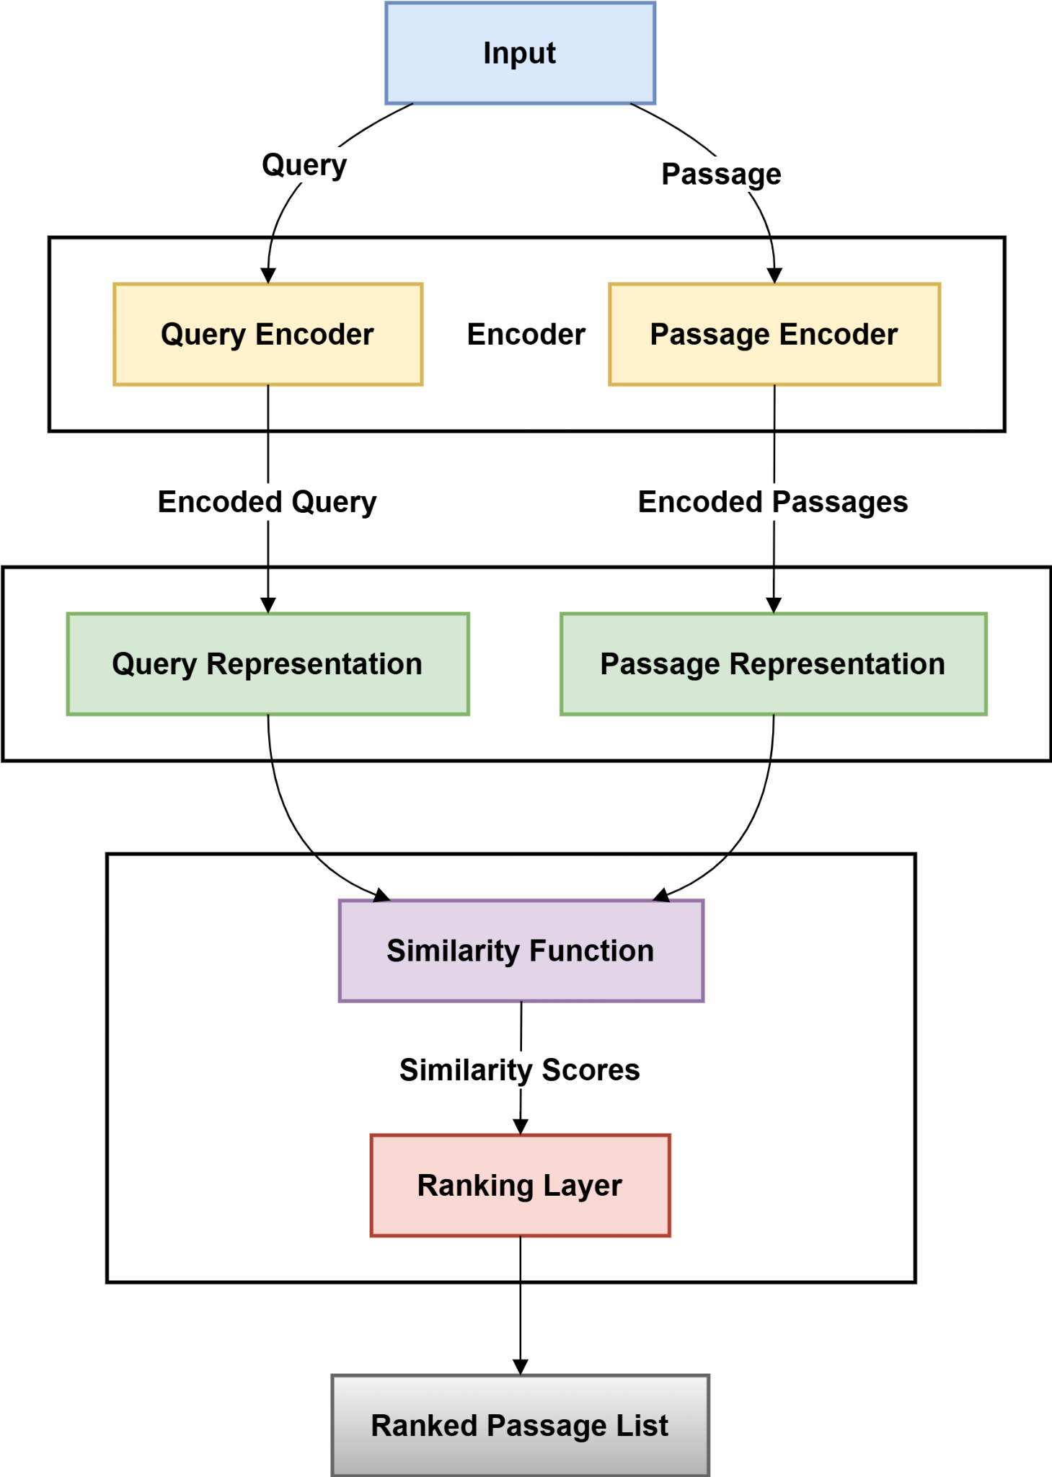
Experimental Design

Slide 8
Experimental Design
5 model variants :
Base SBERT (baseline)
Full Fine-tuning (Random negatives / Hard negatives)
LoRA Fine-tuning (Random negatives / Hard negatives)
Training Data:
1M random samples and 503k hard negatives vs base 1B samples in base model
For building the hard negatives dataset we used our base model to retrieve top 200 passages for each training query. Randomly sampled a passage from range 51 to 100, excluding known positives to get our hard negative. This hard negative is semantically similar but not relevant.
Hardware: NVIDIA A100 80GB GPU

Slide 9
Experimental Design
Loss function:
Triplet loss was used as the loss function, it is defined as : L_{triplet} = max(0, sim(q, p–) − sim(q, p⁺) + α)
Where sim(q, p) is cosine similarity between queries and passage embeddings and α is the margin parameter. [6]

Slide 10
Key Results - Performance Degradation
MODEL | MRR@10 | MRR@100 | % change in MRR@10
Base SBERT | 0.3026 | 0.3144
Full FT (Random) | 0.2619 | 0.2723 | -13.5%
Full FT (Hard) | 0.2536 | 0.2632 | -16.2%
LoRA FT (Random) | 0.2557 | 0.2664 | -15.5%
LoRA FT (Hard) | 0.2050 | 0.2149 | -32.3%

Slide 11
Key Results - Performance Degradation
Worst Performer: LoRA FT (Hard) with -32.3% degradation
Best Fine-tuned: Full FT (Random), still -13.5% worse than base model
Universal Pattern: No fine-tuning approach succeeded to overcome the benchmark set by the base model.

Slide 12
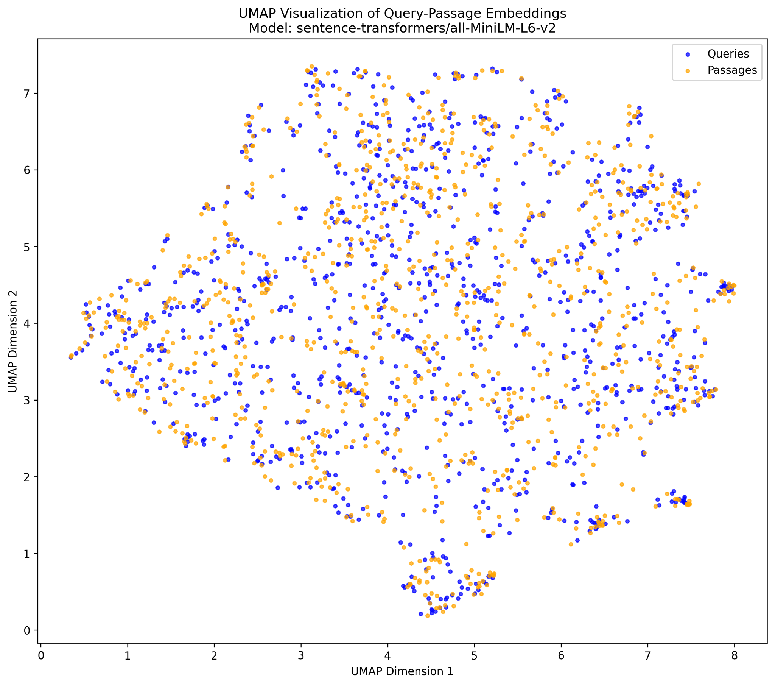
Embedding Space Analysis
Base SBERT: Well-defined semantic clustering
with natural boundaries and balanced distribution

Slide 13
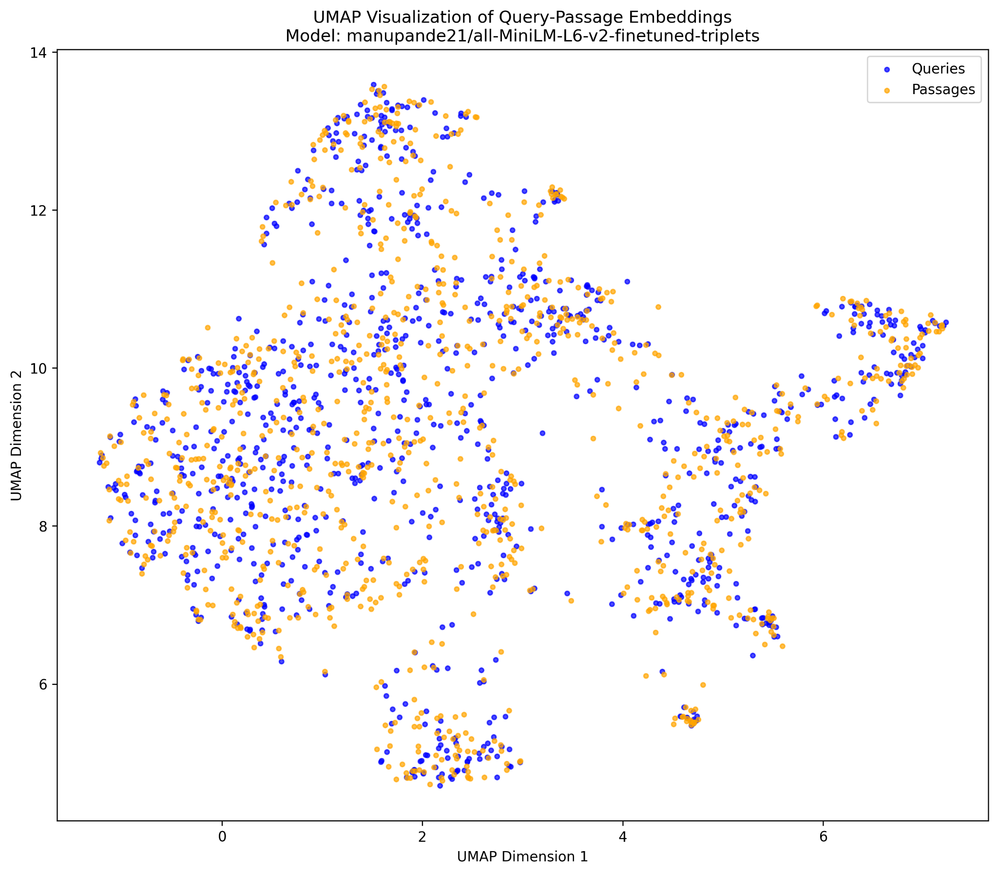
Embedding Space Analysis
Full FT (Random): Distinct island formations
with preserved but altered clustering structure

Slide 14
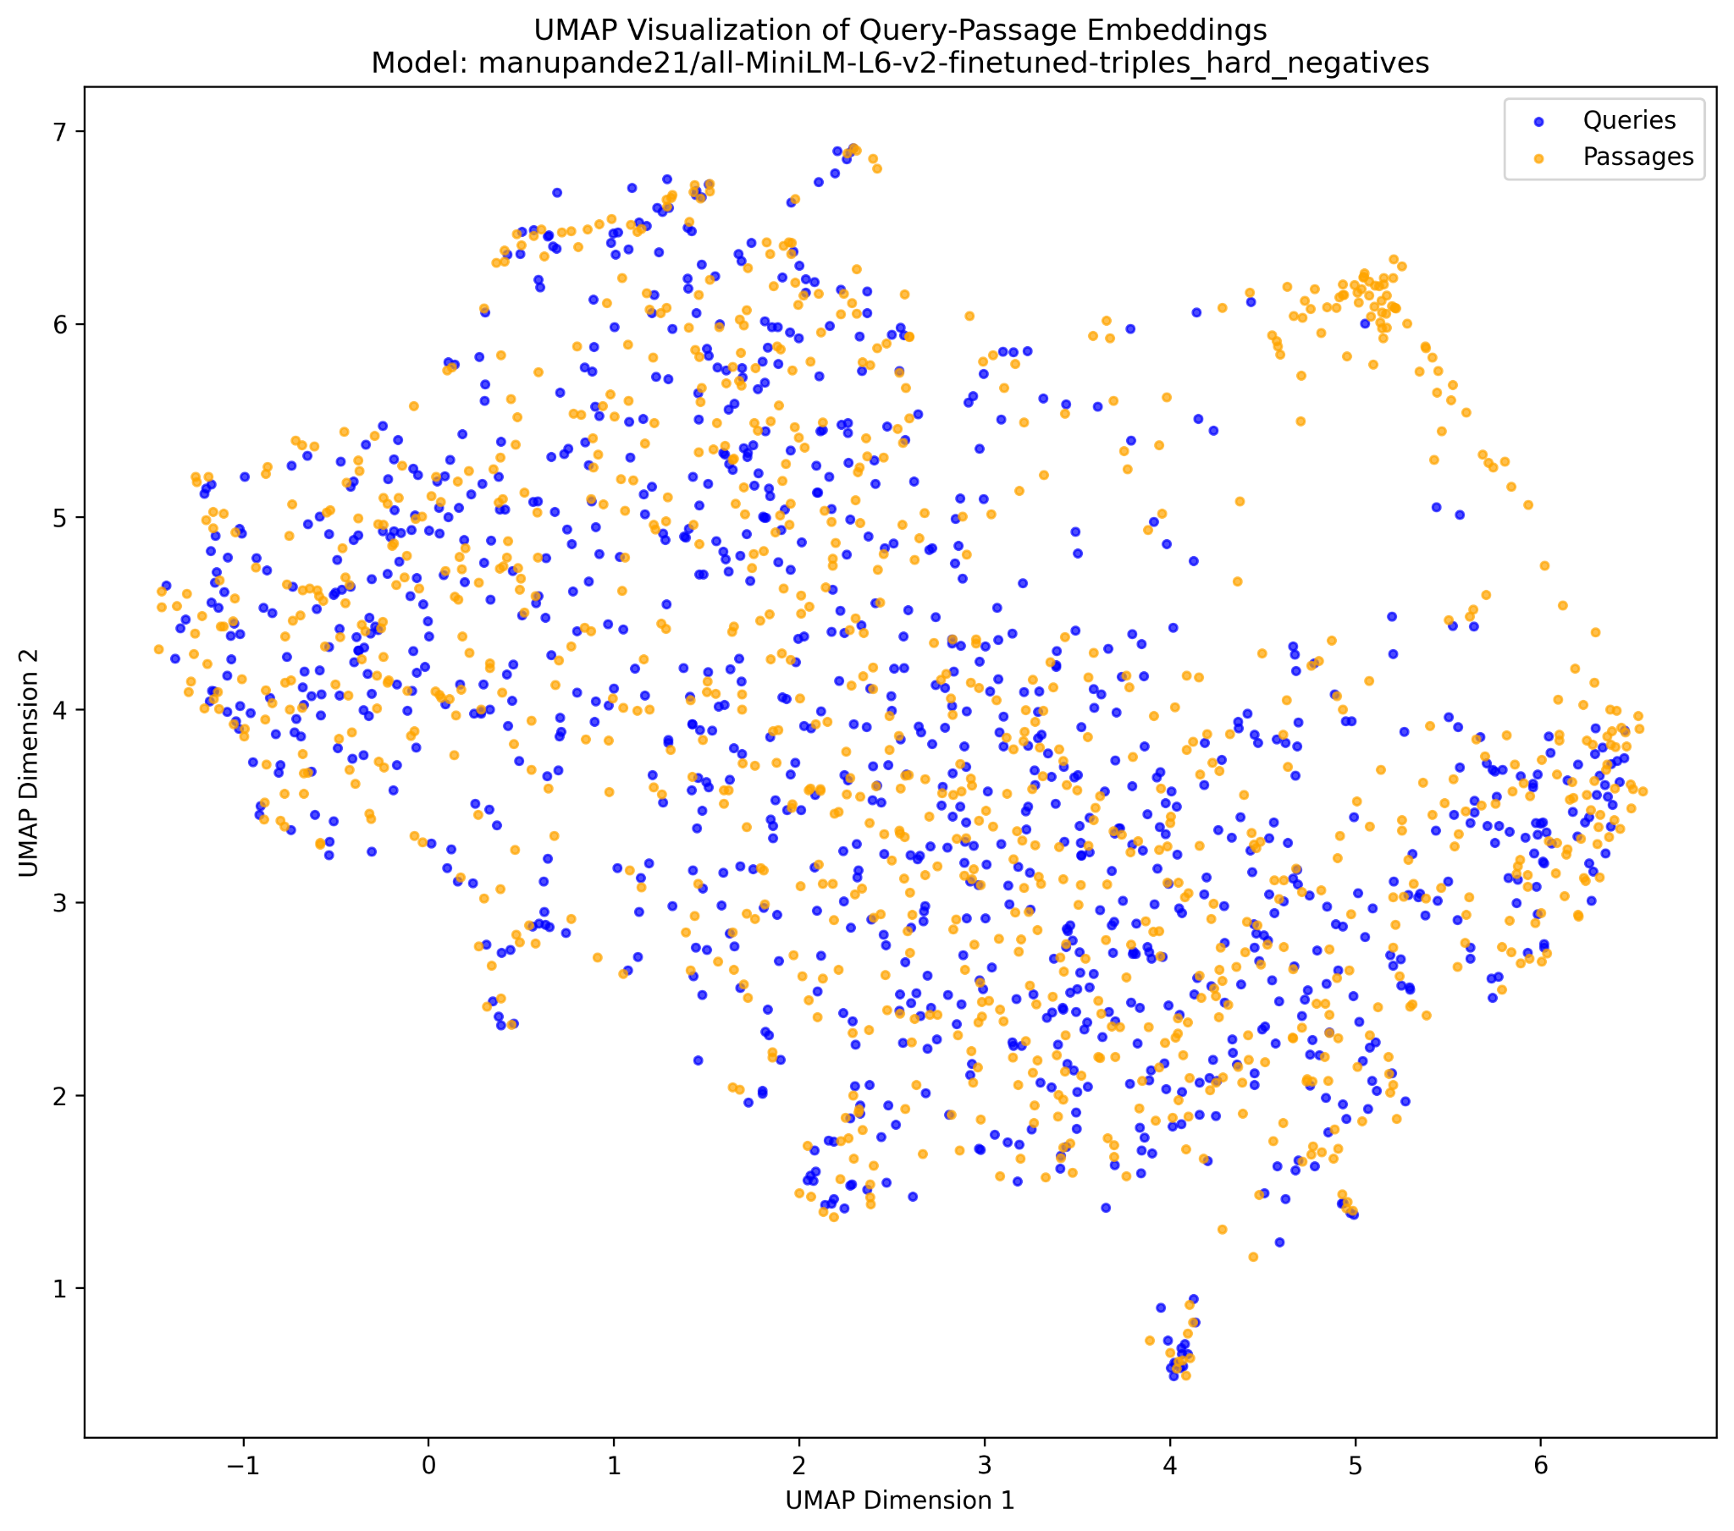
Embedding Space Analysis
Full FT (Hard): Increased uniformity showing
moderate embedding space flattening

Slide 15
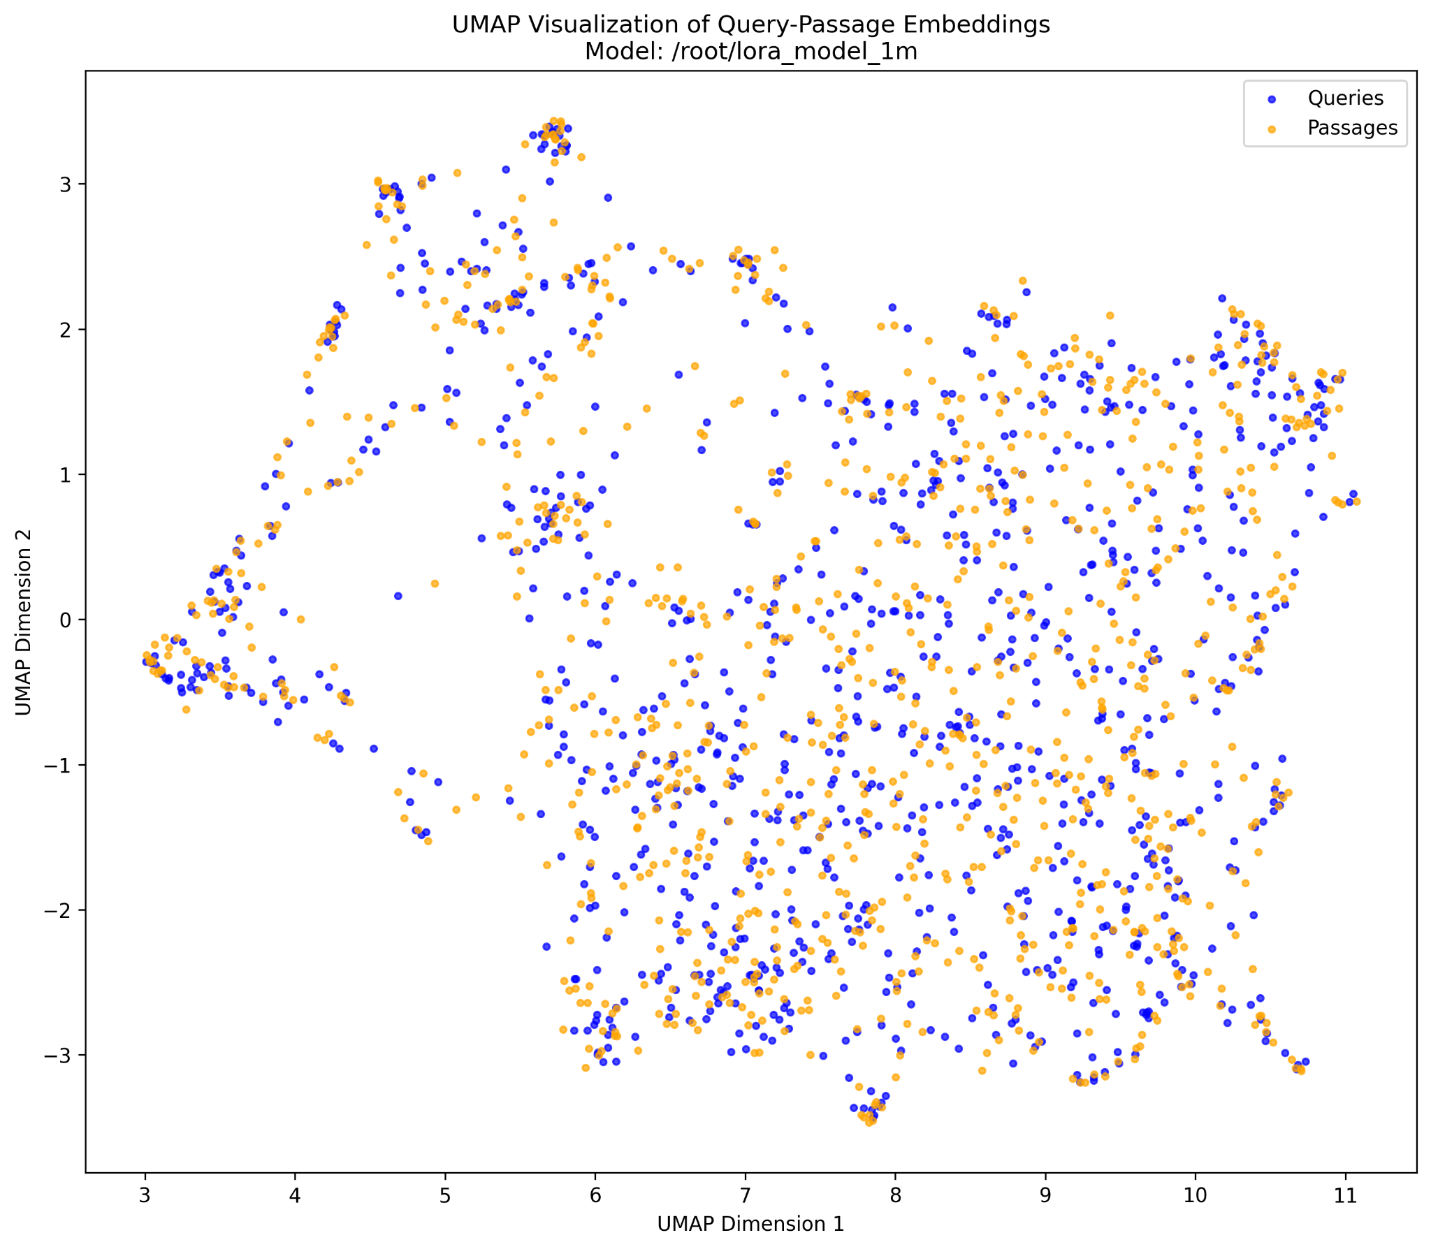
Embedding Space Analysis
LoRA FT (Random): Reduced semantic differentiation
with compressed clustering

Slide 16
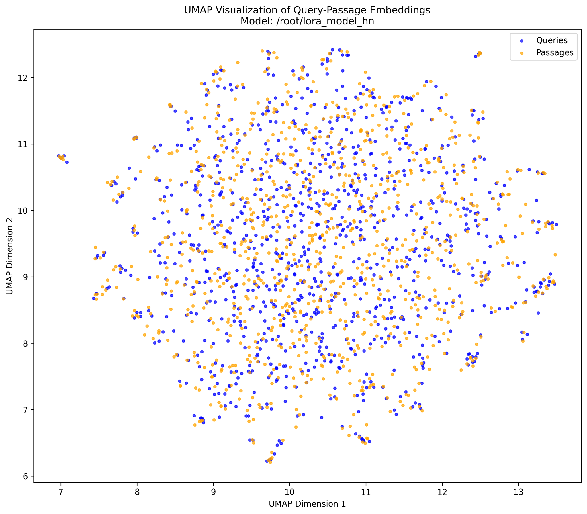
Embedding Space Analysis
LoRA FT (Hard): Maximum uniformity demonstrating
catastrophic embedding space collapse

Slide 17
Embedding Space Analysis
Key Insight: Progressive degradation from structured clustering to uniformity
Visual Correlation: Embedding space quality seems to directly correlate with the observed performance degradation
Mechanism: Fine-tuning disrupts billion-scale learned representations thus adding more noise rather than information signal to the embedding space.

Slide 18
The Hard Negatives Paradox
Counterintuitive Finding: Hard negatives perform worse than random negatives
Explanation: Base model already optimized for semantic similarity
Implication: Conventional negative sampling strategies fail on saturated models
LoRA Vulnerability: Parameter efficient models show catastrophic sensitivity to hard negatives.

Slide 19
Computational Efficiency Surprise
MODEL | TIME (s) | % CHANGE FROM BASE | QUERIES PER SECOND
Base SBERT | 303.92 | — | 32.9
Full FT (Random) | 324.90 | +6.9% | 30.8
Full FT (Hard) | 307.48 | +1.2% | 32.5
LoRA FT (Random) | 574.92 | +89.2% | 17.4
LoRA FT (Hard) | 598.69 | +97.0% | 16.7
Inference time analysis (10k queries)

Slide 20
Computational Efficiency Surprise
LoRA Performance: 2× slower inference despite parameter efficiency
Hidden Costs: Parameter efficiency ≠ computational efficiency
Deployment Impact: Challenges assumptions about LoRA advantages

Slide 21
Key Insights & Implications
The Saturation Hypothesis: Some benchmarks reach optimization limits
Scale Mismatch: 1M fine-tuning samples vs 1B pre-training samples
Embedding Space Preservation: Critical for maintaining performance
Research Paradigm Shift: Need architectural innovation over parameter tuning

Slide 22
Future Directions
Beyond Parameter Tuning: Focus on architectural innovations
Cross-encoder Models: Joint query-document processing
Hybrid Systems: Combine sparse (BM25) + dense retrieval
Alternative Loss Functions: Beyond triplet loss, we can try out MultipleNegativesRankingLoss, Contrastive Loss [6]
Embedding Space Analysis: Should become standard practice and should also include quantitative analysis

Slide 23
Takeaways
Main Finding: Fine-tuning can harm heavily pre-trained models
Methodological Contribution: Embedding space visualization as diagnostic tool
Practical Impact: Challenges conventional transfer learning assumptions
Research Direction: Architecture innovation > parameter optimization

Slide 24
References
Dong, Z., Niu, S., Chen, J., Yang, Y., & Xie, P. (2022). Exploring dual encoder architectures for question answering. In *Proceedings of the 2022 Conference on Empirical Methods in Natural Language Processing (EMNLP)* (pp. 9520-9530).
Lu, M., Chen, C., & Eickhoff, C. (2025). Cross-encoder rediscovers a semantic variant of BM25. *arXiv preprint arXiv:2502.04645*.
Hu, E. J., Shen, Y., Wallis, P., Allen-Zhu, Z., Li, Y., Wang, S., Wang, L., & Chen, W. (2022). LoRA: Low-rank adaptation of large language models. In *Proceedings of the 10th International Conference on Learning Representations (ICLR)*.
McInnes, L., Healy, J., & Melville, J. (2018). UMAP: Uniform manifold approximation and projection for dimension reduction. *arXiv preprint arXiv:1802.03426*.

Slide 25
References
Robertson, S., & Zaragoza, H. (2009). The probabilistic relevance framework: BM25 and beyond. *Foundations and Trends in Information Retrieval*, 3(4), 333-389.
Sentence Transformers, ”Loss Functions Documentation,” 2024.[Online]. Available: https://sbert.net/docs/package_reference/sentence_transformer/losses.html
P. Bajaj et al., ”MS MARCO: A Human Generated MAchine Reading COmprehension Dataset,” arXiv preprint arXiv:1611.09268, 2016.
Hugging Face, ”sentence-transformers/all-MiniLM-L6-v2,” 2024. [Online]. Available: https://huggingface.co/sentence-transformers/all-MiniLM-L6-v2

Slide 26
Acknowledgement
Special thanks to :
Dr. Muneendra Ojha (supervisor) for his guidance and support
Research community for datasets and model availability
Department of IT, IIIT Allahabad for their support
Modal.com for providing computational resources
Family and friends
Your support made this research possible.

